Slide 1
Windows Tech Series Internet Security
Speaker 1
Title
Speaker 2
Title

Slide 2
Agenda
Day | Day 1 Deployment | Day 2 Management | Day 3 Security | Day 4 Windows for CSP
 |  |  |  | Deployment | Management | Security
Synopsis | Module 1 – Introduction | Module 1 – Base System Setup | Module 1 – Analysis Of Common Threats | Module 1 – Windows for SMB Partners
 | Module 2 – Applications & Updates | Module 2 – Configuration | Module 2 – Hardening Windows | Module 2 – Windows Ent. Subscription
 | Module 3 – Windows as a Service (WaaS) | Module 3 – Managing Client Devices | Module 3 – Advanced Threat Protection | Module 3 – Deployment
 | Module 4 – Browsers & Internet Security | Module 4 – Advanced management options I | Module 4 – Information Security (AIP/WIP) | Module 4 – Managing Updates
 | Module 5 – Secure Boot & Device Guard | Module 5 - Advanced management options II | Module 5 – Internet Security

Slide 3
ONLINE SAFETY
Windows includes Windows Defender, an advanced anti-malware solution
Windows and IE SmartScreen blocks malicious websites and apps before they get a chance to impact the device
Protecting the system and apps from the most common forms of malware
Internet Explorer provides zero day protection for commonly used exploit techniques and can prevent the use of unsafe or unpatched browser extension (e.g.: Flash, Java, ActiveX)
Microsoft Edge significantly reduces the browser attack surface and employs extensive controls and hardening to be the most secure Microsoft Web Browser ever shipped.
Notes:
Talk Track
Next let’s talk about zero day’s which is something that customers are constantly asking about. The challenge with a zero day is you don’t know about it until the day it’s used by someone and of course by then it’s too late.
Since it’s impossible to imagine vulnerabilities not being discovered in software we’re investing in defenses that can eliminate to at least mitigate the impact they can have. Some of these mitigations we’ve already talked about earlier when we talked about Platform and App security but I thought I’d show you the impact that these mitigations have had for IE and its users.

Slide 4


COMPREHENSIVE THREAT RESISTENCE
Office ATP
SmartScreen
Windows Firewall
External
Internal
Microsoft Edge
Windows Defender
Device Guard

Slide 5
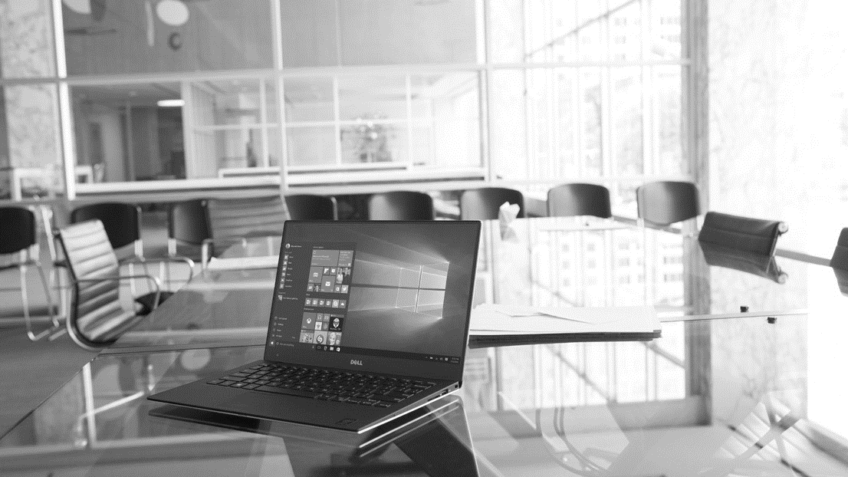
Windows 10
PROTECT FROM THE EDGE
Protect devices before they encounter threats

Slide 6
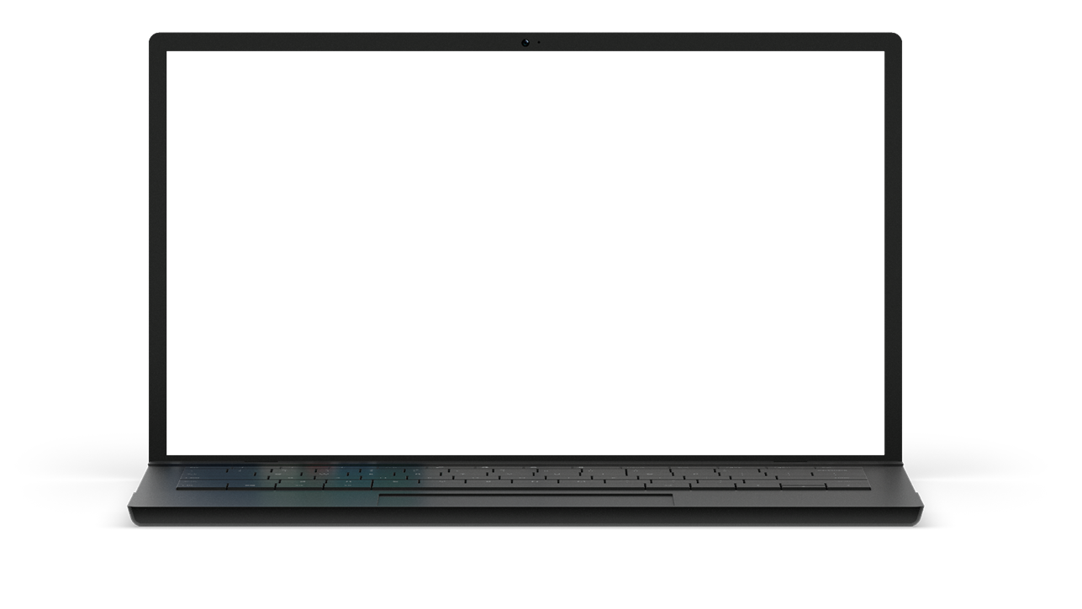
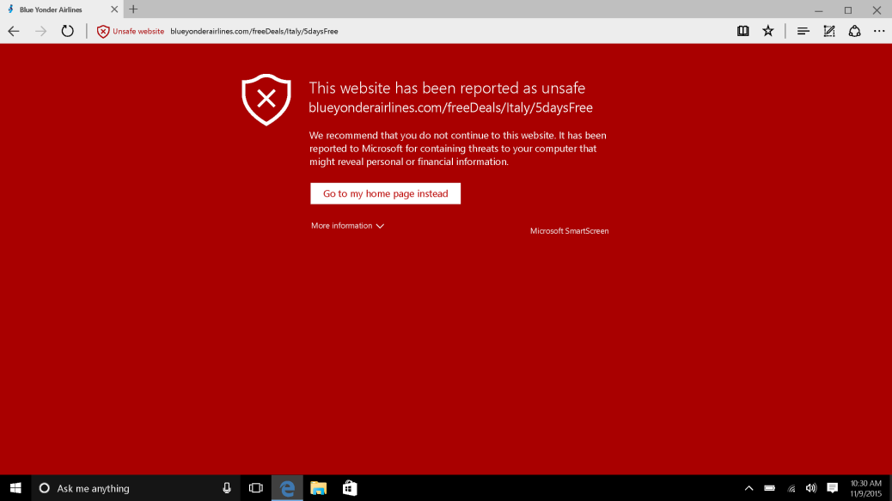
PROACTIVE THREAT IDENTIFICATION AND PROTECTION
Microsoft SmartScreen
Phishing and malware filtering technology for Microsoft Edge and Internet Explorer 11 in Windows 10.
Provides protection from drive-by attacks.
Cloud service is continuously updated, nothing for you to deploy.
Exchange Online Advanced Threat Protection
Cloud-based email filtering service helps protect against unknown malware and viruses.
URL trace technology examines potentially harmful links.

Slide 7
Windows 10
PROTECT FROM WITHIN
Operating system used defense in depth to address threats that get inside the perimeter

Slide 8
Microsoft Edge: Designed for Secure Browsing
Microsoft Edge is the most secure browser Microsoft has ever shipped
Tactics
Objective
Strategy
Eliminate vulnerabilities before attackers can find them
Make it difficult and costly for attackers to find and exploit vulnerabilities in Microsoft Edge
Keep our customers safe when browsing the web
→
→
Break exploitation techniques used by attackers
Contain the damage when vulnerabilities are discovered
Prevent navigation to known exploit sites

Slide 9
Microsoft Edge: BUILDING A SAFER BROWSER
Fundamentally improve security and enable users to confidently experience the web when using Windows 10
www
Defend users
Defend the browser
Identify and block known trickery and fraud
New model for safer browser extensions, extended defenses again memory corruption
Defend against malicious web sites and downloads (SmartScreen)
Stronger, and more convenient, credentials that attackers cannot steal
(Microsoft Passport and Windows Hello)
Supporting new web security standards to block common attacks and prevent impersonation
(Cert. Reputation, EdgeHTML, W3C Content Security Policy,
HTTP Strict Transport Security)
Microsoft Edge is an app, sandboxed by default
(Universal Windows Platform)
Memory randomization space increased dramatically
(Windows Address Space Layout Randomization on 64-bit systems)
Automate memory cleanup, even if program does not
(MemGC)
Dev tools to make it significantly more difficult
to take over an application
(Control Flow Guard)

Slide 10

Microsoft Edge SECURITY Improvements
Before – Full access to Win32.sys
Microsoft Edge and Flash no longer have full access to win32k.sys—API calls are filtered
Only 40% of interfaces are available to Flash and Edge reducing attack surface
Flash player move into its own AppContainer
Working directly with Adobe to harden Flash player to be resistant to vulnerability exploits
Windows Kernel
Microsoft Edge Browser
Edge Content Process
Win32k.sys
Flash Host Process
Today – 60% less surface area of attack on a highly targeted library
Windows Kernel
Microsoft Edge Browser
Edge Content Process
Allowed Win32k.sys interfaces
Flash Host Process
Blocked Win32k.sys interfaces

Slide 11

Microsoft Edge
Windows Defender Application Guard enabling the most secure browsing experience
Windows Defender Application Guard protects the device from advanced attacks launched against Microsoft Edge
Malware and vulnerability exploits targeting the browser, including zero days, are unable to impact the operating system, apps, data and network
Application Guard uses virtualization based security to hardware isolate to isolate Microsoft Edge and any browsing activity away from the rest of the system
Closing Microsoft Edge wipes all traces of attacks that may been encountered while online

Slide 12


Hardware isolation with
Windows Defender application Guard
Microsoft Edge
Apps
Windows Platform Services
Windows Platform Services
Critical System Processes
Kernel
Kernel
Kernel
Windows Defender
Application Guard Container
Windows Operating System
System Container
Hyper-V
Hyper-V
Device Hardware
Hypervisor

Slide 13
Microsoft Edge Security Assurance
Microsoft Edge was built together with in house security experts
Fuzzing/Static Analysis
Code Review/Penetration Testing
REDTEAM
Greater than 670 machine years devoted to fuzz testing Microsoft Edge and Internet Explorer during development
More than 400 billion DOM manipulations generated from 1 billion html files
Hundreds of security issues addressed
Security review of all key features resulted in over 70 security review engagements
Dozens of security implementation and design issues addressed prior to ship
Security static analysis checkers integrated into Edge builds and
Windows REDTEAM emulates the techniques and expertise of skilled real-world attackers
Exploited Microsoft Edge vulnerabilities discovered through penetration testing
End result in improved mitigation of new novel attacks discovered prior to shipping Microsoft Edge
Ongoing Microsoft “Bug Bounty” Programs

Slide 14
Measuring Microsoft Edge Security Improvements
Number of exploited web browser CVEs
Number of days with known zero day exploit in the wild
Number of RCE CVEs by web browser version
Number of exploited Microsoft web browser Remote Code Execution (RCE) CVEs by patch year
Number of days with known Microsoft web browser Remote Code Execution (RCE) zero day in the wild before patch
Number of Remote Code Execution (CVEs) addressed in 2015 by web browser version
No known zero day exploit for a Microsoft RCE CVE that works against IE11 on Windows 8.1+ for 19 months
No known exploits in-the-wild that target Microsoft Edge
75% reduction in RCE CVEs that affect Microsoft Edge in the first 5 servicing months

Slide 15
Conclusion
Microsoft Edge was built from the ground up to mitigate current and future exploit techniques
Each iteration of Microsoft Edge introduces new and innovative security features to keep attackers in a disrupted state
Microsoft Edge has seen no zero-day exploits or in-the-wild-attacks since shipping

